Slide 1
A Re-introduction to Web services
IN712 Web 3

Slide 2
Announcement
No class next week (6/6/17 and 8/6/2017)
Time for you to carry out independent learning on the React framework
Bonus Marks opportunities:
13/6/17: articulating your own abstract thoughts around Ethical issues in web technologies
15/6/17: presentations about web technologies not covered in the paper

Slide 3
What exactly is a web service?
In its simplest form, a web service is a framework for a conversation between two computers
A client sends request over the Internet and a server receives that request and returns a response
When a browser makes a request for a webpage, it receives HTML and other related content in the response
But when a client just asks for data and programmatically processes the response, a web service (API) has been used
Web services typically have very strict requirements for usage that are documented for developers
Modern web service communications are nearly always handled over HTTP
But the format of the message that are being sent and received can differ greatly
Web services are therefore, the great decouplers of modern computing.
The client doesn't understand how the server works and vice versa
They work together through a shared vocabulary

Slide 4
History of Web services
The concept of two computers communicating with each other using a shared vocabulary in order to share business information is not new, (EDI, Electronic Data Interchange)
In the early 1990's a standard known as RPC, or Remote Procedure Call, emerged
RPC systems allow client computers to call functions, or subroutines, hosted by remote computers using syntax as similar as possible to the code they might use locally
Microsoft quickly followed up with their own flavor: MSRPC.
Followed by Microsoft's COM OLE architecture.
Also in the early 1990's, a competing standard named CORBA, for Common Object Request Broker Architecture, emerged
Java's RMI, for Remote Method Invocation, was an interface designed to communicate over the internet inter-ORB protocol (IIOP)
Each of the above standards had their own protocols, message formats and supported programming languages and operating systems.
They all had in common, a level of complexity that made them difficult to get started with, and difficult to use.

Slide 5
Message Formats for web services: XML
In 1998, the world of web services was revolutionized with the introduction of XML or Extensible Markup
It's goals were simplicity, readability, and generality
Unlike EDI or the binary formats of some other systems, XML is plain text and when formatted as a high reticule set of nested tags, is easy to read for human eyes
XML was also ideal in many ways, for data exchange
Because it has strict formatting rules, you can easily validate whether a particular XML snippet properly represents expected data.
It quickly became one of the most common formats for web service messages.
Atom and RSS are some of the best known XML based languages used in today's web services.
But there're literally thousands of different XML languages designed to represent all sorts of data models.

Slide 6
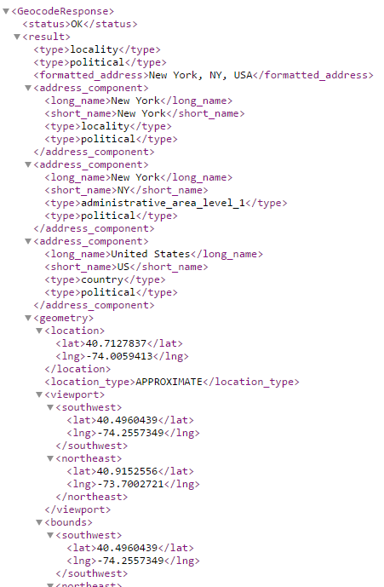
Message Formats for web services: XML
http://maps.googleapis.com/maps/api/geocode/xml?address=New%20York

Slide 7
Message Formats for web services : JSON
JSON (JavaScript Object Notation) is a lightweight data-interchange format.
It is easy for humans to read and write.
It is easy for machines to parse and generate.
JSON is a syntax for serializing objects, arrays, numbers, strings, booleans, and null
It is based upon JavaScript syntax but is distinct from it
JSON is built on two structures:
A collection of name/value pairs. In various languages, this is realized as an object, record, struct, dictionary, hash table, keyed list, or associative array
An ordered list of values. In most languages, this is realized as an array, vector, list, or sequence
These are universal data structures. Virtually all modern programming languages support them in one form or another. It makes sense that a data format that is interchangeable with programming languages also be based on these structures.

Slide 8
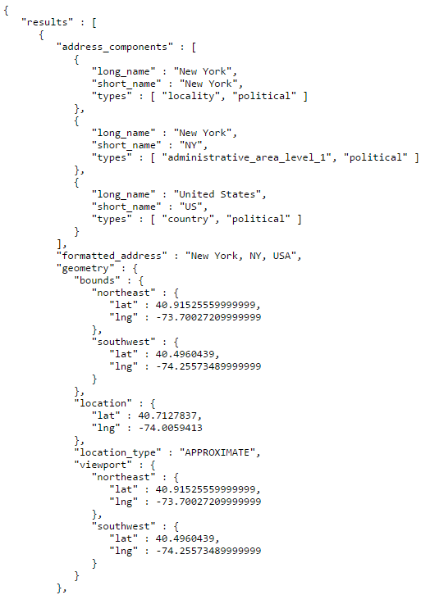
Message Formats for web services: JSON
http://maps.googleapis.com/maps/api/geocode/json?address=New%20York

Slide 9
Message Formats for web services: Other
Action Message Format or AMF
binary format that was originally created for Macromedia's Flash
HTML
it isn't particularly well suited for structure data but is sometimes used for it anyway
Comma or tab separated files
Arbitrary text formats that require custom parsers
Binary formats including
Spreadsheets
Archive data bases
Image files

Slide 10
Web Service Standards: SOAP
Strictly speaking a message format
An XML based markup language with a very specific set of tags, attributes and supported data types
The introduction of SOAP in the late 1990s triggered the broad spread use of web services in all sorts of applications.
It led to the new buzz phrase, Service Oriented Architecture or SOA
Developers who used SOAP based services, don't need to deal directly with the underlying XML messages. Instead they call functions, known as operations, that are defined by the service they're using
The resulting code in a client-side application can look almost exactly like a function they might call in their local client environment
The translation of outgoing requests and incoming responses is handled by the underlying SOAP library implementation.

Slide 11
Web Service Standards: SOAP
In the early 2000s, SOAP was the dominant web services standard
SOAP's major downside is in its verbocity. Its request and response messages are encoded in a plaint text XML with a lot of attributes and annotations
As a result, its messages simply require more text than slimmer message formats, such as JSON
Also, the engines that are required to do the creation and parsing of SOAP messages are of varying quality.
The developer has to trust the libraries to do the right thing, work efficiently and quickly and translate everything from XML to native data types and back again
For developers who like to know exactly what's happening at run-time this is all a little too high level

Slide 12
Using SOAP, a request looks like this:
Querying a phonebook application for the details of a given user:
<?xml version="1.0"?>
<soap:Envelope
xmlns:soap="http://www.w3.org/2001/12/soap-envelope" soap:encodingStyle="http://www.w3.org/2001/12/soap-encoding">
<soap:body pb="http://www.acme.com/phonebook">
<pb:GetUserDetails>
<pb:UserID>12345</pb:UserID>
</pb:GetUserDetails>
</soap:Body>
</soap:Envelope>

Slide 13
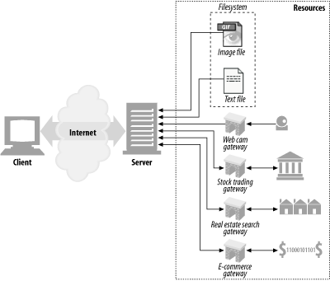
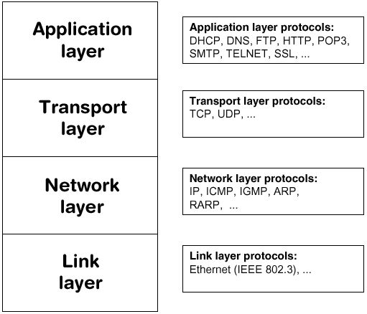
Web Resources
As the web gain popularity, several people noticed that the HTTP protocol could be used to build web services
Recall that HTTP is used by web browsers and other client applications to communicate in real time over the worldwide web
HTTP is a simple text-based vocabulary that lets computers exchange requests and responses
A web service conversation over HTTP starts with a client computer forming and sending a request message
The server receives and processes the request by executing whatever actions are requested and then forms and sends back a response.
Other transport protocols
FTP, SMTP, POP

Slide 14
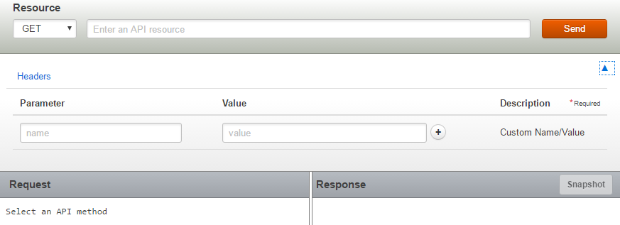
REST Console
Useful tool to study HTTP requests and response messages
https://apigee.com/console/others
Accept-Language
Sample URL: http://maps.googleapis.com/maps/api/geocode/xml?address=New%20York

Slide 15
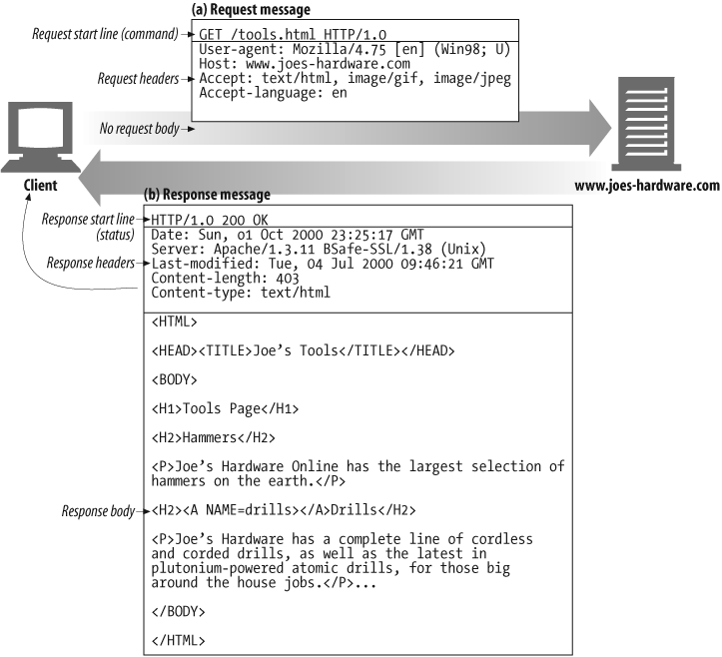
Example GET transaction

Slide 16
Web Service Standards: REST
Sometime in the mid 2000s much of the web services world started moving to what are known as REST (or RESTful) web services
The term REST stands for Representational State Transfer
REST requirements are lighter weight than those of SOAP, and only require that web services use simple HTTP request response messaging
REST is an architecture, not a specific web service messaging format, and it's wrapped around the concept of HTTP methods or verbs

Slide 17
Web Service Standards: REST
A GET request is different from a POST request
PUT and DELETE requests can also have their own meaning. REST services can exploit these differences. Translating them into specific server side actions
All you need is a client that's capable of forming and sending the requests, which are typically in the form of URIs (Uniform Resource Identifiers)
Unlike SOAP, RESTful services don't all use the same message format
One service might return data in a XML based language such as RSS or Atom.
Or in a custom XML language designed for a particular business process.
Or for the sake of speed and efficient use of bandwidth. It might encode it's data in JSON.
Or HTML

Slide 18
Web Service Standards: REST
Over the past half decade as developers have shifted their focus to building applications for mobile devices speed and message size have become critical factors
Mobile devices have less storage than desktop computers, and cell phone users pay by the megabyte for the bandwidth they consume.
Due to it's verbosity and resulting size, SOAP isn't well suited to the mobile world. Instead, RESTful web services using JSON message format are increasingly popular

Slide 19
Using REST, requests looks like this:
Querying a phonebook application for the details of a given user:
GET /phonebook/UserDetails/12345 HTTP/1.1
Accept: application/xml
Creating a new user in the application:
POST /phonebook/UserDetails/12346 HTTP/1.1
Name=Peter
Phone=987 654 321
Editing information about an existing user in the application:
PUT /phonebook/UserDetails/12346 HTTP/1.1
Name=Peter
Phone=(01) 987 654 321
Deleting information about an existing user in the application:
DELETE /phonebook/UserDetails/12346 HTTP/1.1

